Slide 1
Content
Introduction to Relational Data Model
Key
Types of Keys
Relationship between keys
References

Slide 2
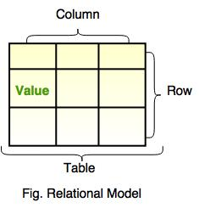
Relational Data Model
Data is viewed as existing in two dimensional tables known as relations
A relation (table) consists of unique attributes (columns) and tuples (rows)
Relational Database: Any database whose logical organization is based on relational data model.
RDBMS: A DBMS that manages the relational database.
Relational database simplifies the database structure by making use of tables.
This model was first proposed by E. F. Codd.

Slide 3
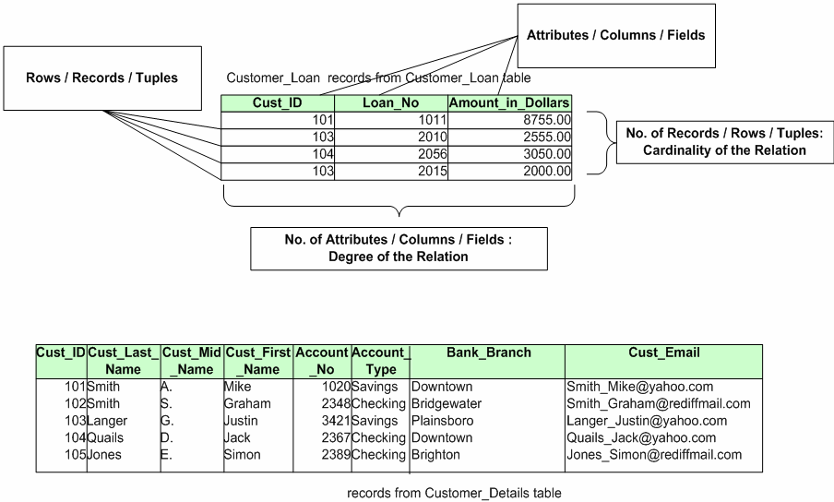

Slide 4
Null Values
Sometimes the value to be inserted into a particular cell may be unknown, or it may have no value.
This is represented by a NULL
Null is not the same as zero, blank or an empty string

Slide 5
Key in a Relation
A unique value for an entity.
An attribute or a set of attributes which can uniquely identify all the entities of the entity set (or each record of a table).
Here, EmpNo is the key for this Relation.
EmpNo | EName | EDeptNo
1001 | Elsa | D1
1002 | John | D2
1003 | Maria | Null
1004 | Maida | D1

Slide 6
Types Of Keys
1. Super Key:
a set of attributes which specifies that no two tuples (of a relation) is same.
OR
‘K’ is the super key of a Schema ‘R’ if values for k are sufficient to identify unique tuple of each possible relation r(R).
No two tuples can have same values for super key.
Super set of super key is also a super key.
E.g.: Super key set-
{Name, Author},
{BookID},
{BookID, Name, Author}
BookID | Name | Author
1001 | X | D1
1002 | Y | D2
1003 | X | D3
1004 | M | D1

Slide 7
Types Of Keys
2. Candidate Key:
Minimal super key (super key without redundancy) is known as Candidate Key.
A Candidate key is not reducible as it has no redundancy.
However, any subset of these set of attributes would not identify a row uniquely
There can be more than one candidate keys in a relation.
Overlapping candidate keys: Two candidate keys overlap if they involve any attribute in common.
E.g.: Candidate Key:
{Name, Author}
{BookID}
{BookID,Name, Author} is not a candidate key as BookID alone is able to uniquely identify a tuple.
BookID | Name | Author
1001 | X | D1
1002 | Y | D2
1003 | X | D3
1004 | M | D1

Slide 8
Key Attributes and Non Key Attributes
Key Attributes:
The attributes that participate in the Candidate key are Key attributes
Non-Key Attributes:
The attributes which do not participate in the Candidate key.

Slide 9
Types Of Keys
Primary key:
During the creation of the table, the Database Designer chooses one of the Candidate Key amongst the several available, to uniquely identify row in the given table.
The candidate key that is chosen to perform the identification task is called the primary key
Composite primary key : A primary key which is a combination of more than one attribute.
Every tuple must have, by definition, a unique value for its primary key.
While Selecting Primary Key:
Give preference to numeric column(s)
Give preference to single attribute
Give preference to minimal composite key

Slide 10
Types Of Keys
Alternate Key:
The candidate key that is chosen to perform the identification task is called the primary key and the remaining candidate keys are known as alternate keys.
No of Alternate Keys = No of Candidate Keys - 1

Slide 11

Example

Slide 12


Slide 13
Relationship Between Keys
Super Key
Candidate Key
Primary Key

Slide 14
Types Of Keys
Foreign key
This key established relation between two tables (relation).
A Foreign Key is a set of attribute (s) of a table, whose values are required to match values of some Candidate Key in the same or another table. (Specifically primary key).
Usually a foreign key is a “copy” of a primary key that has been exported from one relation into another to represent the existence of a relationship between them.
Foreign Key column must match the values of the corresponding Candidate Key column. This is known as Referential constraint.
A table which has a Foreign Key referring to its own Candidate Key is known as Self-Referencing table
Foreign key is used to keep database small and to reduce redundancy.

Slide 15
To enter the data in child table corresponding data must be present in master table or NULL is the default entry in child table in the referenced column ( FK column)
Foreign key values do not (usually) have to be unique.
Foreign keys can also be null .
DEPT
(Parent /Master/Referenced Table)
EMP
(Child /Referencing Table)
DeptNo | DName
D1 | IVS
D2 | ENR
EmpNo | EName | EDeptNo
1001 | Elsa | D1
1002 | John | D2
1003 | Maria | Null
1004 | Maida | D1

Slide 16
Summary
Introduction to relational Data Model
Key
key attribute and Non-key Attributes
Types of Keys
Relationship between keys
References

Slide 17
References
Elmasri, Navathe, “ Fundamentals of Database Systems”, Addision Wesley
Korth, Silbertz, Sudarshan,” Database Concepts”, McGraw Hill
Date C J, “An Introduction to Database Systems”, Addision Wesley
Thank You

